Slide 1
CS246: LDA Inference
Junghoo “John” Cho
UCLA

Slide 2
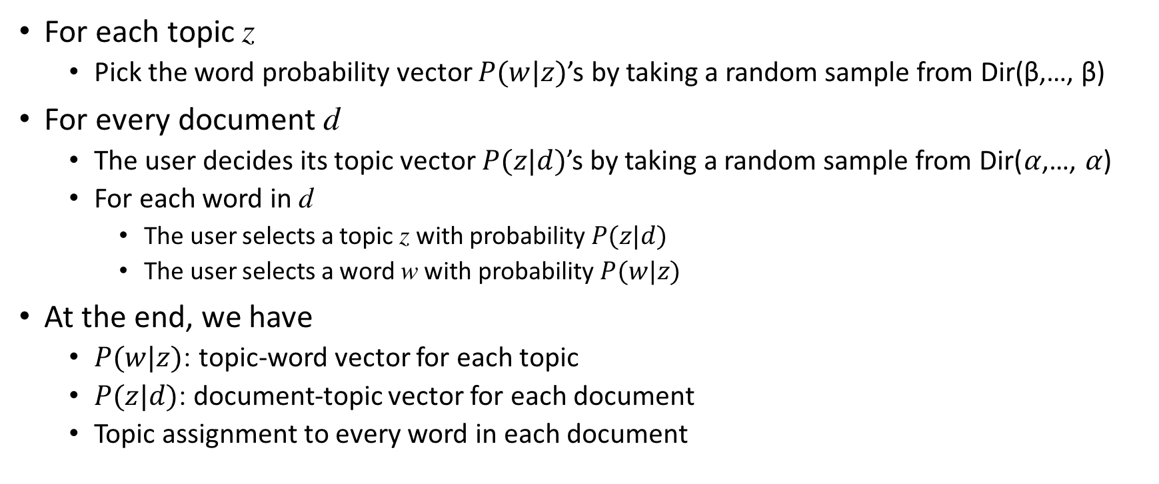
LDA Document Generation Model
For each topic z
  Pick the word probability vector $P(w|z)$’s by taking a random sample from Dir(β,…, β)
For every document d
  The user decides its topic vector $P(z|d)$’s by taking a random sample from Dir(⍺,…, ⍺)
  For each word in d
    The user selects a topic z with probability $P(z|d)$
    The user selects a word w with probability $P(w|z)$
At the end, we have
  $P(w|z)$: topic-word vector for each topic
  $P(z|d)$: document-topic vector for each document
  Topic assignment to every word in each document

Slide 3
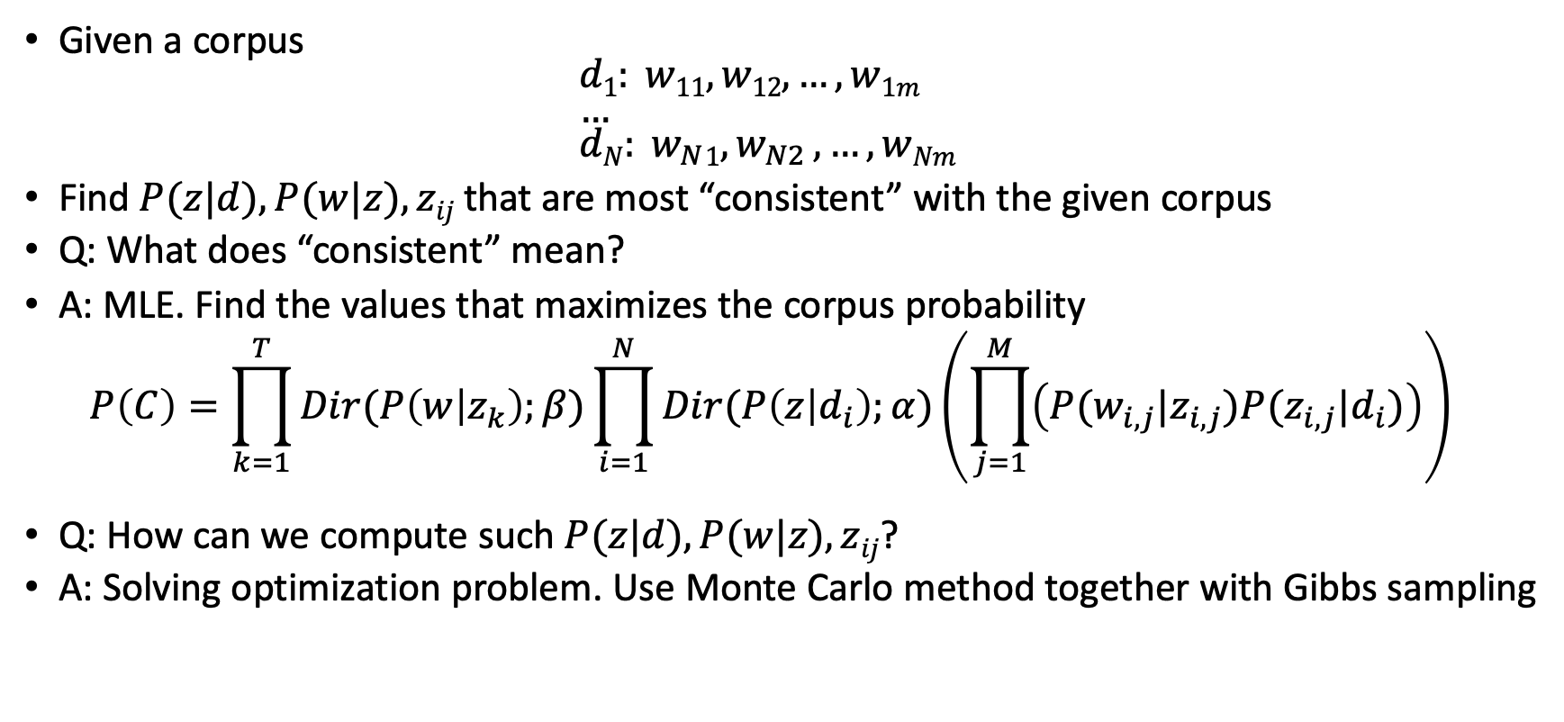
LDA as Topic Inference
Given a corpus
$d1: w11, w12, …, w1m$
$…$
$dN: w_{N}1{,w}_{N2},…,wNm$
Find $P(z|d), P(w|z), zij$that are most “consistent” with the given corpus
Q: What does “consistent” mean?
A: MLE. Find the values that maximizes the corpus probability
$P\left(C\right)=\prod_{k=1}^{T}{Dir(P\left(w | z_{k}\right);β)}\prod_{i=1}^{N}{Dir(P\left(z | d_{i}\right);α)\left(\prod_{j=1}^{M}{\left(P(w_{i,j}|z_{i,j})P(z_{i,j}|d_{i})\right)}\right)}$
Q: How can we compute such $P(z|d), P(w|z), zij$?
A: Solving optimization problem. Use Monte Carlo method together with Gibbs sampling

Slide 4

Monte Carlo Method (1)
Class of methods that compute a number through repeated random sampling of certain event(s).
Q: How can we compute $π$?

Slide 5
Monte Carlo Method (2)
Define the domain of possible events
Generate the events randomly from the domain using a certain probability distribution
Perform a deterministic computation using the events
Aggregate the results of the individual computation into the final result
Q: How can we take random samples from a particular distribution?

Slide 6
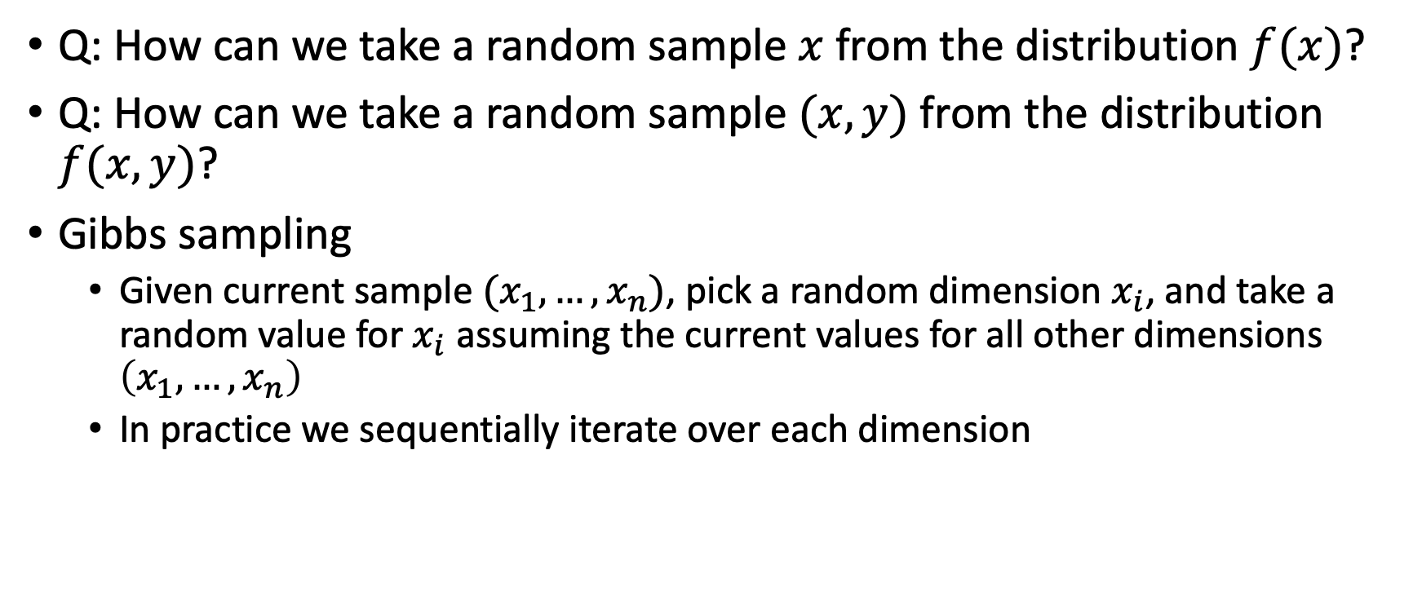
Gibbs Sampling
Q: How can we take a random sample $x$ from the distribution $f(x)$?
Q: How can we take a random sample $(x, y)$ from the distribution $f(x, y)$?
Gibbs sampling
  Given current sample $(x_{1}, …, x_{n})$, pick a random dimension $x_{i}$, and take a random value for $x_{i}$ assuming the current values for all other dimensions $\left(x_{1}, …, x_{n}\right)$
  In practice we sequentially iterate over each dimension

Slide 7
Markov-Chain Monte-Carlo Method (MCMC)
Gibbs sampling is in the class of Markov Chain sampling
  Next sample depends only on the current sample
Markov-Chain Monte-Carlo Method
  Generate random events using Markov-Chain sampling and apply Monte-Carlo method to compute the result

Slide 8
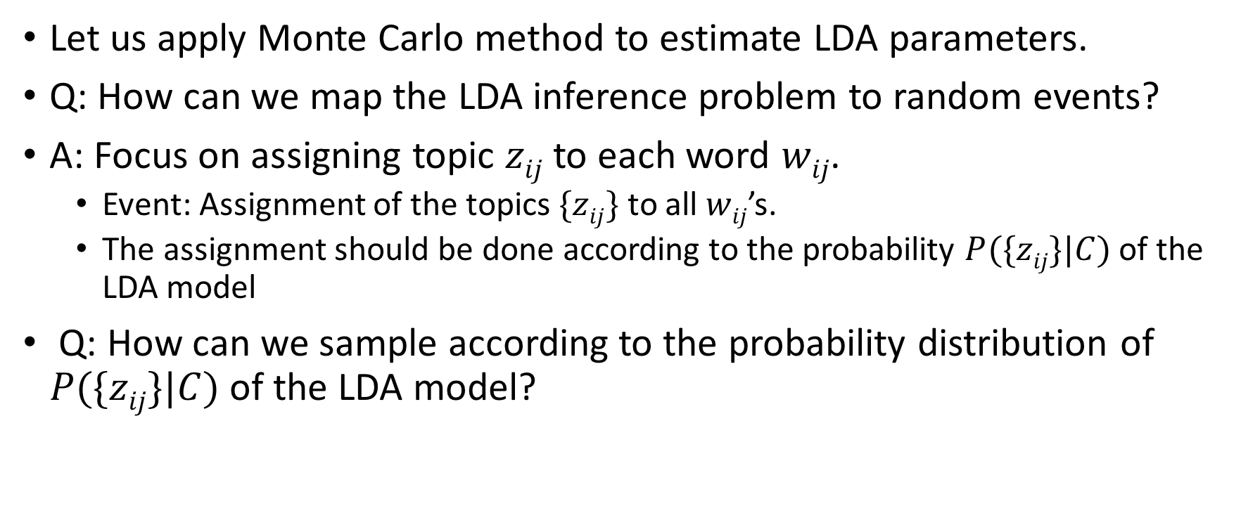
Applying MCMC to LDA
Let us apply Monte Carlo method to estimate LDA parameters.
Q: How can we map the LDA inference problem to random events?
A: Focus on assigning topic $zij$ to each word $wij$.
  Event: Assignment of the topics $\{zij\}$ to all $wij$’s.
  The assignment should be done according to the probability $P(\{zij\}|C)$ of the LDA model
Q: How can we sample according to the probability distribution of $P(\{zij\}|C)$ of the LDA model?

Slide 9
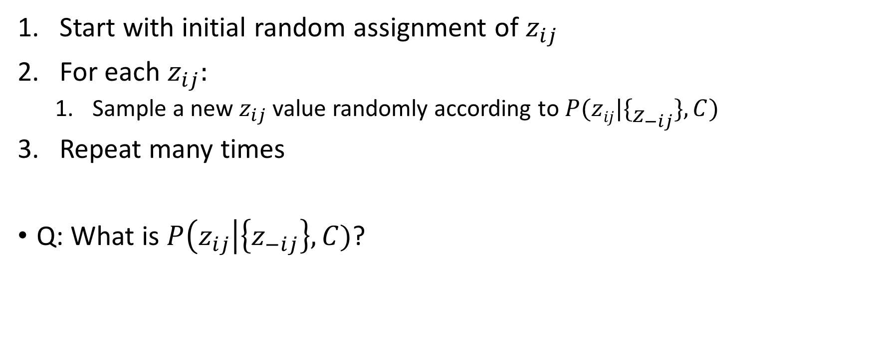
Gibbs Sampling for LDA
Start with initial random assignment of $z_{ij}$
For each $z_{ij}:$
  Sample a new $z_{ij}$ value randomly according to $P(zij|\{z_{−ij}\},C)$
Repeat many times
Q: What is $P\left(z_{ij}\right|\left\{z_{−ij}\right\},C)$?

Slide 10

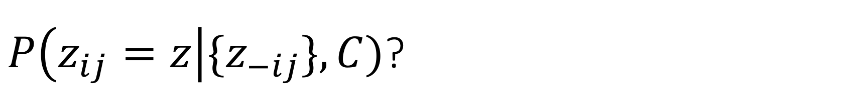
$P\left(z_{ij}=z\right|{\{z}_{−ij}\},C)$?
$P\left(z_{ij}=z\right|\{z_{−ij}\},C)∝\left(\frac{n_{w_{ij}z} + β}{\sum_{w=1}^{W}{{(n}_{wz}+β)}}\right)\left(\frac{n_{d_{i}z}+α}{\sum_{z=1}^{T}{(n_{d_{i}z}+α)}}\right)$
  $nwz$: how many times the word w has been assigned to the topic z
  $ndz$: how many words in the document d have been assigned to the topic z
Q: What is the meaning of each factor?

Slide 11
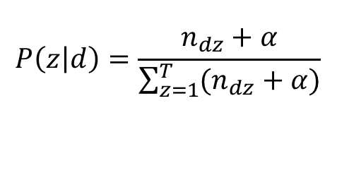
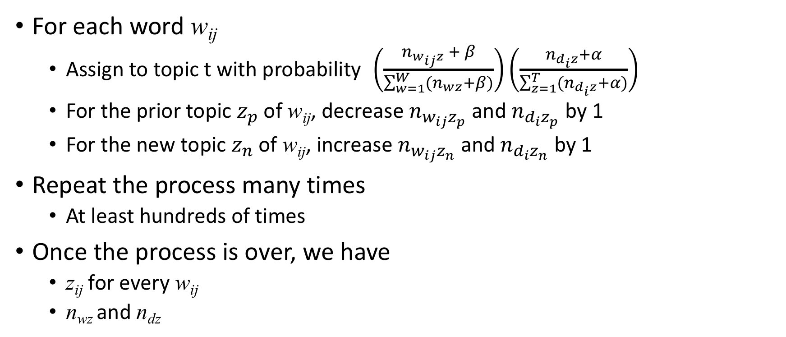
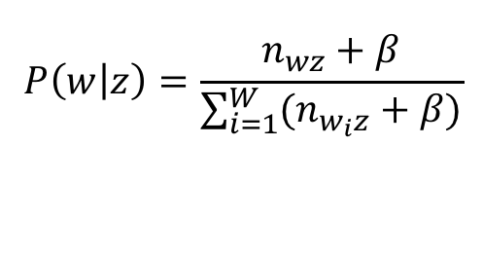
LDA with Gibbs Sampling
For each word w_{ij}
  Assign to topic t with probability $\left(\frac{n_{w_{ij}z} + β}{\sum_{w=1}^{W}{{(n}_{wz}+β)}}\right)\left(\frac{n_{d_{i}z}+α}{\sum_{z=1}^{T}{(n_{d_{i}z}+α)}}\right)$
  For the prior topic $z_{p}$ of w_{ij}, decrease $n_{w_{ij}z_{p}}$ and $n_{d_{i}z_{p}}$ by 1
  For the new topic $z_{n}$of w_{ij}, increase $n_{w_{ij}z_{n}}$and $n_{d_{i}z_{n}}$ by 1
Repeat the process many times
  At least hundreds of times
Once the process is over, we have
  z_{ij} for every w_{ij}
  n_{wz} and n_{dz}
$$P\left(w | z\right)=\frac{n_{wz}+β}{\sum_{i=1}^{W}{(n_{w_{i}z}+β)}}$$
$$P\left(z | d\right)=\frac{n_{dz}+α}{\sum_{z=1}^{T}{(n_{dz}+α)}}$$

Slide 12
Example Result from LDA
TASA corpus
  37,000 text passages from educational materials collected by Touchstone Applied Science Associates
  Set T=300 (300 topics)

Slide 13
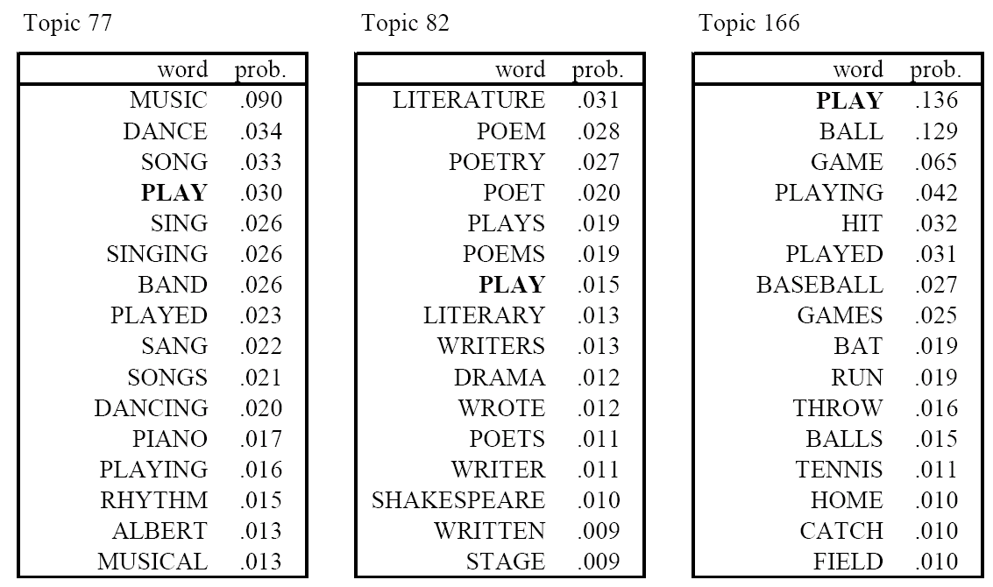
Inferred Topics

Slide 14
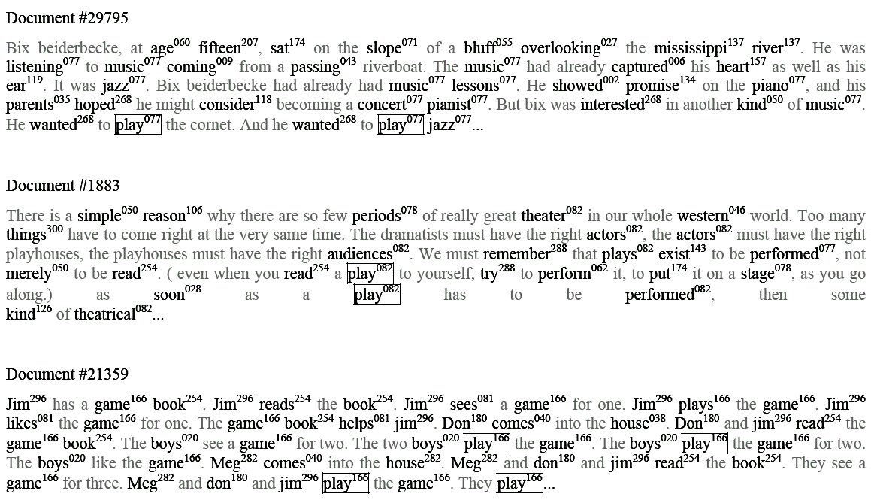
Word Topic Assignments

Slide 15
LDA Algorithm Simulation
Two topics: River, Money
Five words: “river”, “stream”, “bank”, “money”, “loan”
Generate 16 documents by randomly mixing the two topics and using the LDA model
 | river | stream | bank | money | loan
River | 1/3 | 1/3 | 1/3
Money |  |  | 1/3 | 1/3 | 1/3

Slide 16
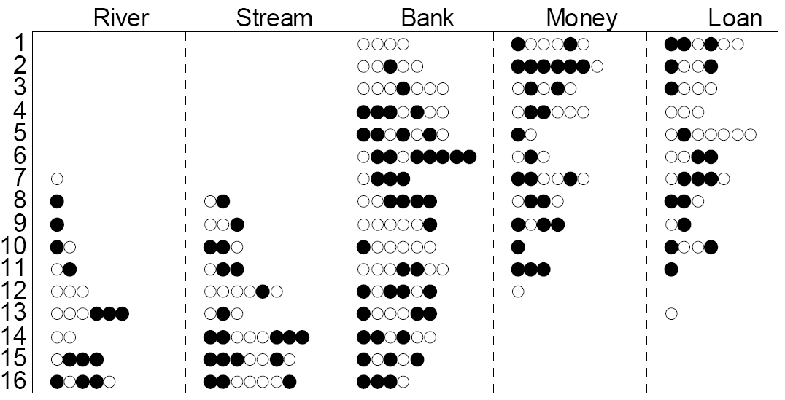
Generated Documents and Initial Topic Assignment before Inference
First 6 and the last 3 documents are purely from one topic. Others are mixture
White dot: “River”. Black dot: “Money”

Slide 17
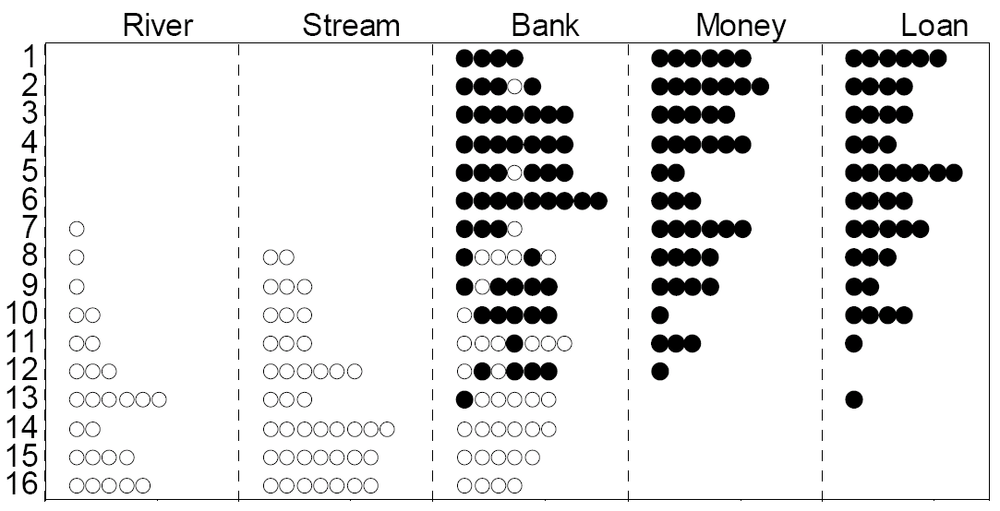
Topic Assignment After LDA Inference
First 6 and the last 3 documents are purely from one topic. Others are mixture
After 64 iterations

Slide 18
Inferred Topic-Term Matrix
Model parameter
Estimated parameter
Not perfect, but very close especially given the small data size
 | river | stream | bank | money | loan
River | 0.33 | 0.33 | 0.33
Money |  |  | 0.33 | 0.33 | 0.33
 | river | stream | bank | money | loan
River | 0.25 | 0.4 | 0.35
Money |  |  | 0.32 | 0.29 | 0.39

Slide 19
LSI vs LDA
Both perform the following decomposition
SVD views this as matrix approximation
LDA views this as probabilistic inference based on a generative model
  Each entry corresponds to “probability”: better interpretability
term
topic
term
topic
=
X
doc
doc

Slide 20
LDA as Soft Classification
Soft vs hard clustering/classification
After LDA, every document is assigned to a small number of topics with some weights
  Documents are not assigned exclusively to a topic
  Soft clustering

Slide 21
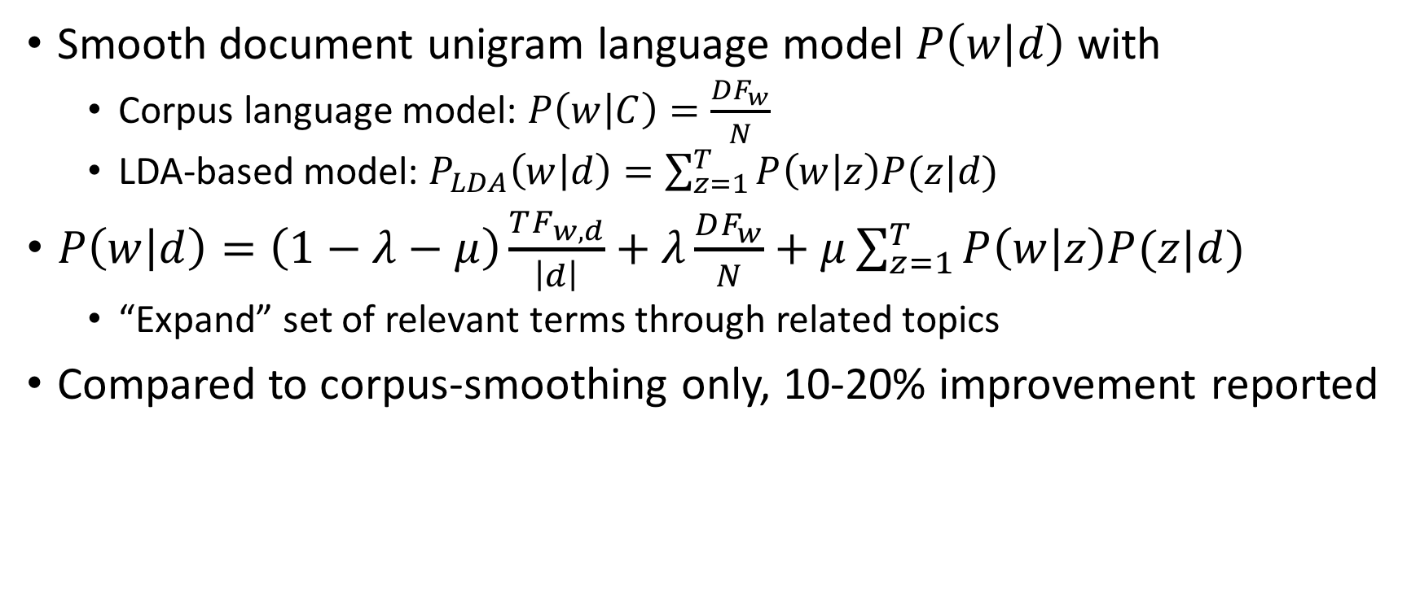
LDA: Application to IR [Wei & Croft 2006]
Smooth document unigram language model $P\left(w | d\right)$ with
  Corpus language model: $P\left(w | C\right)=\frac{DF_{w}}{N}$
  LDA-based model: $P_{LDA}\left(w | d\right)=\sum_{z=1}^{T}{P\left(w | z\right)P(z|d)}$
$P\left(w | d\right)=\left(1−λ−μ\right)\frac{TF_{w,d}}{\left|d\right|}+λ\frac{DF_{w}}{N}+μ\sum_{z=1}^{T}{P\left(w | z\right)P(z|d)}$
  “Expand” set of relevant terms through related topics
Compared to corpus-smoothing only, 10-20% improvement reported

Slide 22
pLSI and NMF
In general, pLSI can be viewed as matrix factorization with constraints that factored matrices may have values between [0, 1] only
  Nonnegative matrix factorization (NMF): many algorithms exist
term
topic
term
topic
=
X
doc
doc

Slide 23
Summary
Probabilistic Topic Model
  Generative model of documents
  Latent Dirichlet Analysis (LDA)
  Nonnegative matrix factorization
Statistical parameter estimation for LDA
  Multinomial distribution and Dirichlet distribution
  Monte Carlo method
  Gibbs sampling
    Markov-Chain class of sampling
Language model “smoothing” through LDA model

Slide 24
References
[Wei & Croft 2006] Xing Wei and W. Bruce Croft: LDA-Based Document Models for Ad-hoc Retrieval in SIGIR 2006

